Slide 1
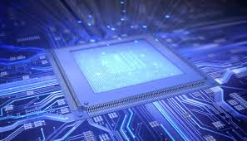

Malla Reddy Engineering College And Management Sciences Medhcal
WSN based Mobile and PC Control Room Environment for Industrial Applications
M.Tech Thesis Presentation
Presented By
Mr. Tirunagari Raghavendra
14UJ1D5520
Date: 28-12-2015

Slide 2

IT CONTAINS
Introduction
Hardware Components
Software's Used
Necessity of technology
Existing project
Architecture
Design
Functionality
Advantages
Future Scope
Utilities and Applications
Conclusions

Slide 3
INTRODUCTION
The usage of robotics is increasing day by day to reduce the manpower
for many reasons and uses with high navigational intelligence.
The aim of developing a modern robot control system is to provide higher
flexibility.
In recent years there is a vast technology improvements in industrial
control rooms for monitoring the entire field of Industrial plants.
High end PLC’s are being implemented for controlling the entire process
of fields.
But a problem is that even though automation takes the complete control
of total plants few authentication and manual actions are needed from user
side for completing the control action.

Slide 4
Hence there is a must situation for users presence at all times in the control
room for taking some timely needed control actions.
The proposed system approach provides a good solution to this problem.
The whole control room environment is additionally implemented in the
microcontroller platform and the same is communicated to the process
through GSM and ZigBee.
Now the user in control room can be mobile at anytime, anywhere to monitor
and control the whole plant.
At the same time the control parameters can be send to the desktop computer.
A microcontroller board is used here for acquiring process control parameters
from the sensors and transmitting it via a GSM module to a mobile and ZigBee
module to a desktop.

Slide 5
Hence the parameter values can be monitored and stored simultaneously.
We can monitor the industrial parameters such as gas, liquid level, moving
motion detection, fire. If fire detected buzzer will on and a cooling fan
switched on.
If gas leaked buzzer will on. If liquid overflows buzzer will on. For
security purpose human detection sensor can be used. If any obstacle find
the robot will change the direction by using IR sensor.
All the parameters are send via GSM and ZigBee.
This project uses regulated 5V, 500mA power supply. 7805 three terminal
voltage regulator is used for voltage regulation.
Bridge type full wave rectifier is used to rectify the ac output of secondary
of 230/12V step down transformer.

Slide 6
Hardware Components
LPC2148 ARM Microcontroller
GSM Module
ZigBee module
Fire Sensor
GAS Sensor
Level Sensor
PIR Sensor
IR Sensor
LCD Display
ULN2003 Relay Driver
Cooling Fan
L293D Motor Driver
DC Motors
Buzzer.

Slide 7
LPC2148 ARM Microcontroller
Features:
32-bit ARM7TDMI-S microcontroller.
40 kB of on-chip static RAM and 32 kB to 512 kB of on-chip flash memory.
In-System Programming/In-Application Programming (ISP/IAP)‏.
8 kB of on-chip RAM accessible to USB by DMA.
Two 10-bit ADCs provide a total of 14 analog inputs.
10-bit DAC provides variable analog output.
Two 32-bit timers/external event counters (with four capture and four compare
channels each)‏.

Slide 8
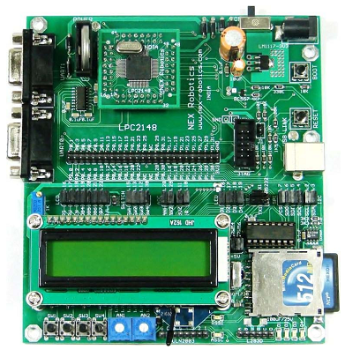
PWM unit (six outputs).
watchdog timer.
Real-Time Clock (RTC) with independent power.
Multiple serial interfaces including
-- two UARTs,
-- Two Fast I2C-bus (400 kbit/s), ARM 7 LPC2148
-- SPI and SSP with buffering and variable data length capabilities.
Vectored Interrupt Controller (VIC) with configurable priorities and vector
addresses.
45 general purpose I/O pins.
21 external interrupt pins available.
On-chip integrated oscillator operates with an external crystal from 1 MHz to
25 MHz.

Slide 9
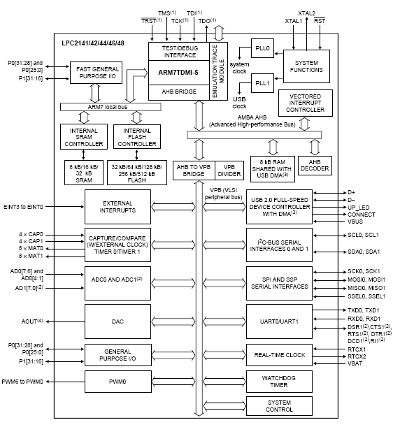
BLOCK DIAGRAM OF ARM 7 LPC2148

Slide 10
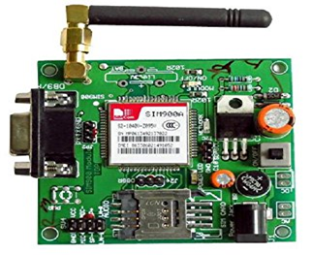
GSM MODULE
GSM Definition
-- GSM stands for Global System for Mobile Communications.
-- One of the leading digital cellular systems.
-- GSM uses narrowband TDMA, which allows eight simultaneous
calls on the same radio frequency.
GSM Features
-- Compatibility that we can use the same mobile to make calls in
several countries.
-- Noise Robust such that digital GSM is better than analog because it
suffer from noise therefore using digital will reduce the noise.
-- Flexibility and increased capacity due to equipment is smaller size.
GSM Module
-- Any GSM module is using the normal GSM network.
-- GSM modules can be communicated to LPC2148- microcontroller
using normal serial USART protocol.
-- Communication is being done using regular GSM modem AT
commands.

Slide 11
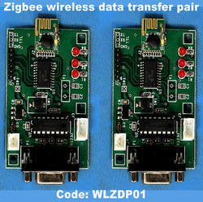
ZigBee MODULE
What is ZigBee?
-- ZigBee is a new wireless technology .
-- Technological Standard Created for Control and Sensor Networks.
-- Based on the IEEE 802.15.4 Standard.
-- Created by the ZigBee Alliance.
-- Philips, Motorola, Intel, HP are all members of the alliance.
-- Designed for low power consumption allowing batteries to
essentially last for ever.
-- ZigBee makes possible completely networked homes where all
devices are able to communicate and be controlled by a single unit.

Slide 12
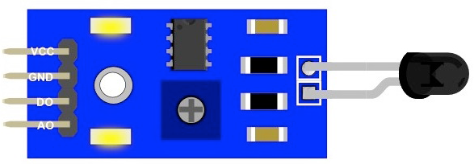
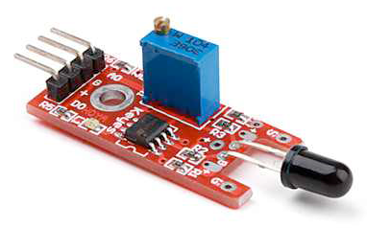
Fire Sensor
Introduction
-- Fire Sensor is also known has Flame Sensor Module.
-- This module is sensitive to the flame and radiation.
-- It also can detect ordinary light source in the range of a wavelength
760nm-1100 nm.
-- The detection distance is up to 100 cm.
-- The Flame sensor can output digital or analog signal.
-- It can be used as a flame alarm or in fire fighting robots.
Description
-- Detects a flame or a light source of a wavelength in the range of
760nm-1100 nm.
-- Detection distance: 20cm (4.8V) ~ 100cm (1V).
-- Detection angle about 60 degrees, it is sensitive to the flame spectrum.
-- Comparator chip LM393 makes module readings stable.
-- Adjustable detection range.
-- Operating voltage 3.3V-5V.
-- Digital and Analog Output
1. DO digital switch outputs (0 and 1)
2. AO analog voltage output
-- Power indicator and digital switch output indicator.

Slide 13
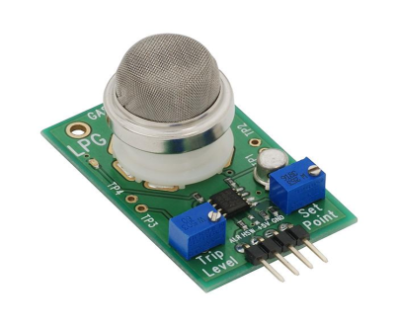
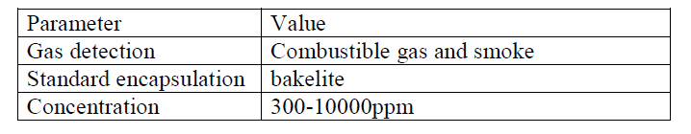
Gas Sensor
Gas Sensor MQ2
-- Gas Sensor is also known has Smoke Sensor.
-- Sensitive material of MQ-2 gas sensor is SnO2 (Tin Dioxide), which
is lower conductivity in clean air.
-- When the target combustible gas exist, The sensor’s conductivity
is more higher along with the gas concentration rising.
-- Please use simple electro circuit, Convert change of conductivity
to correspond output signal of gas concentration.
Features
-- Good sensitivity to Combustible gas in wide range.
-- High sensitivity to LPG, Propane and Hydrogen.
-- Long life and low cost.
-- Simple drive circuit.
Specifications

Slide 14
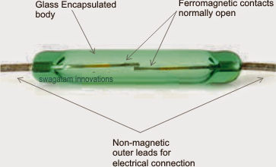
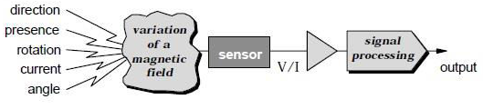
Level Sensor
What is Level Sensor?
-- Level Sensor is also known has Magnetic Sensor.
-- The Sensors, transducers which uses the changes in magnetic field for
their operations.
-- Used to measure the currents, speed, position and Displacement.
-- As the conventional sensors, Magnetic sensor does not give output
parameters directly.
-- Signal processing is required for desired output.
Working of Magnetic Sensor

Slide 15
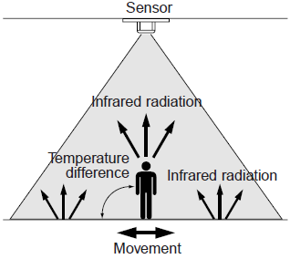
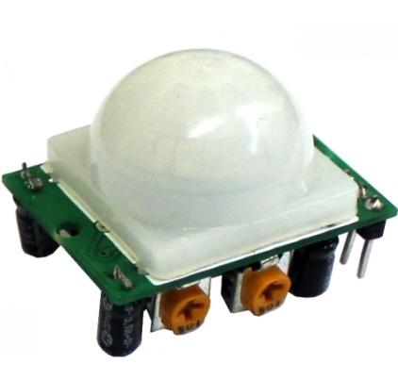
PIR Sensor
What is PIR Sensor?
-- PIR sensor stands for passive infrared sensor.
-- A passive infrared sensor (PIR sensor) is an electronic sensor that
measures infrared (IR) light radiating from objects in its field of
view.
-- They are most often used in PIR based motion detectors.
-- All objects with a temperature above absolute zero emit heat energy in
the form of radiation.
Working of PIR Sensor
PIR 325 Sensor

Slide 16
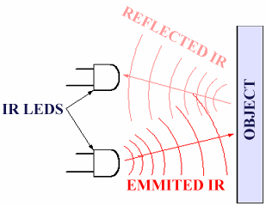
IR Sensor
What is IR Sensor?
-- IR sensor stands for infrared sensor.
-- An infrared sensor is an electronic device, that emits in order to sense
some aspects of the surroundings.
-- An IR Sensor can measure the heat of an object as well as detects the
motion.
-- These types of sensors measures only infrared radiation, rather than
emitting it that is called as a passive IR sensor.
-- Usually in the infrared spectrum, all the objects radiate some form of
thermal radiations.
-- These types of radiations are invisible to our eyes, that can be detected by
an infrared sensor.
-- The emitter is simply an IR LED (Light Emitting Diode) and the detector
is simply an IR photodiode which is sensitive to IR light of the same
wavelength as that emitted by the IR LED.
-- When IR light falls on the photodiode, The resistances and these output
voltages, change in proportion to the magnitude of the IR light received.

Slide 17
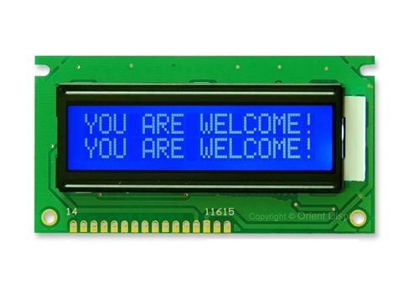
LCD Display
Introduction of LCD Display
-- LCD stands for Liquid Crystal Display.
-- Mostly used for Display of Message.
-- Highly user interactive.
-- We are using 16x2 character LCD.
-- 16x2 LCD means max 16 characters per line can be displayed and
there are 2 lines.
-- Single character is displayed in 5x7 pixel matrix.
Features of LCD Display
-- 5 x 8 dots with cursor.
-- Built in controller (KS 0066 or Equivalent).
-- + 5V power supply (Also available for + 3V).
-- 1/16 duty cycle.
-- B/L to be driven by pin 1, pin 2 or pin 15, pin 16 or A.K (LED).
-- N.V. optional for + 3V power supply.

Slide 18
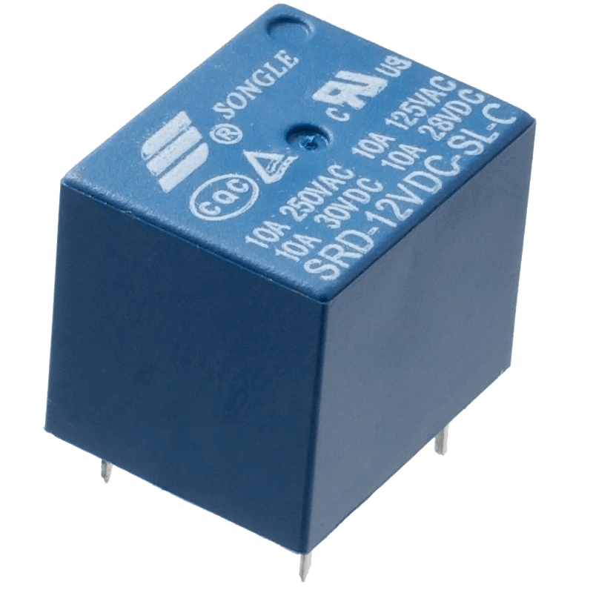
ULN2003 Relay Driver
Introduction of ULN2003 Relay Driver
-- A relay is an electrically operated switch.
-- Many relays use an electromagnet to mechanically operate a switch,
but other operating principles are also used, such as solid-state relays.
-- Relays are used where it is necessary to control a circuit by a low power
signal (with complete electrical isolation between control and controlled
circuits), or where several circuits must be controlled by one signal.
-- The first relays were used in long distance telegraph circuits as amplifiers:
they repeated the signal coming in from one circuit and re-transmitted it
on another circuit.
-- Relays were used extensively in telephone exchanges and early computers
to perform logical operations.

Slide 19
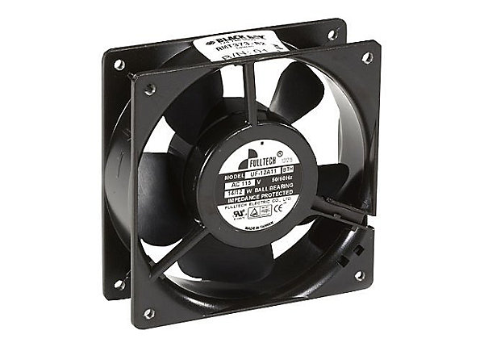
Cooling Fan
Introduction of Cooling Fan
-- Cooling fan is used regulate the device temperature.
-- To remove excess heat from the device.
Cooling System
-- An automobile's cooling system is the collection of parts and
substances (coolants) that work together to maintain the engine's
temperature at optimal levels.
-- Comprising many different components such as coolant, a thermostat
etc.
-- The system enables smooth and efficient functioning of the device at
the same time protecting it from damage.
-- An automotive cooling system must perform several functions
1. Remove excess heat from the device.
2. Maintain a consist device temperature.

Slide 20
L293D Motor Driver
What is L293D Motor Driver ?
-- The L293 and L293D are quadruple high-current half-H drivers.
-- The L293 is designed to provide bidirectional drive currents of up to
1 A at voltages from 4.5 V to 36 V.
-- The L293D is designed to provide bidirectional drive currents of up
to 600-mA at voltages from 4.5 V to 36 V.
-- L293 is quadruple half-H driver i.e. in L293 all four input- output
lines are independent.
-- Output current per channel = 1A for L293. Hence, heat sink is
provided in L293.
-- Protective Diodes against back EMF are provided internally in
L293D.

Slide 21
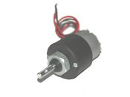
DC Motor
Introduction of DC Motor
-- It is a low cost DC motor suitable for most robotic and general
applications.
-- It has a output shaft with a hole for easy mounting of wheels or
pulleys.
-- Input Voltage: 6-12 V.
-- Stall Current: 500 - 600 mA.
-- Shaft length: 2.4 cm.
-- DC Motor has100 rpm (rotation per minute).

Slide 22
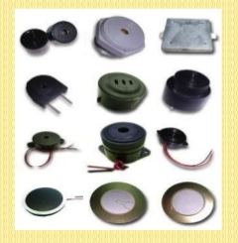
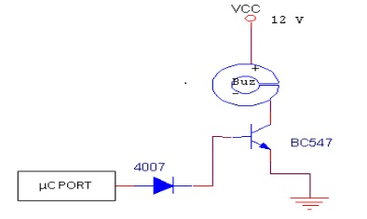
Buzzer
-- The buzzer is an output transducers converting electrical energy to
sound.
-- A buzzer is a signalling device, usually electronic, typically used in
automobiles, household appliances, industrial appliances.
-- They contain an internal oscillator to produce the sound which is set
at about 400Hz for buzzers.
-- Buzzers have a voltage rating but it is only approximate, for example
6V and 12V buzzers can be used with a 9V supply. Their typical
current is about 25mA.
-- Buzzers must be connected the right way round, their red lead is
positive (+).
What is Buzzer?

Slide 23
Software's Used
Keiluv4 IDE Tool
Proteus_v7.8i
HYPERTERMINAL
uc Flash USB
Keiluv4 IDE Tool
-- Keil was founded in 1982 by Gunter and Reinhard Keil; initially as a
German GbR.
-- In April 1985 the company was converted to Keil Electronic GmbH to
market add-on products for the development tools provided by many of the
Silicon vendors.
-- Keil implemented the first C compiler designed from the ground-up
specifically for the 8051 microcontroller.
-- Keil provides a broad range of development tools like ANSI C compiler,
macro assemblers, debuggers and simulators, linkers, IDE, library
managers, real-time operating systems and evaluation boards for Intel
8051, Intel MCS-251, ARM, andXC16x/C16x/ST10families.

Slide 24
Proteus_v7.8i
-- The Proteus Design Suite is an Electronic Design Automation (EDA)
tool including schematic capture, simulation and PCB Layout modules.
-- The Proteus Design Suite is the tool used for simulation before
executing the code in a circuit board because of safety of a kit.
-- It is developed in Yorkshire, England by Lab center Electronics Ltd
with offices in North America and several overseas sales channels.
-- The software runs on the Windows operating system and is available in
English, French, Spanish and Chinese languages..
HyperTerminal
-- HyperTerminal is also known as HyperAccess.
-- HyperTerminal is used to show the output in a personal computer.
with the help of ZigBee.
-- HyperAccess is a family of terminal emulation software by Hilgraeve.
-- A version of HyperAccess, called HyperTerminal is included in some
versions of Windows.

Slide 25
uc Flash USB
-- The uc Flash USB Programmer is an affordable, reliable, and fast
programmer for MCS51/AVR Microcontrollers and 24Cxx I2C EEPROMs.
-- This uc Flash USB tool is used to dump the code into a device.
-- The programmer is designed to operate with the Intel Pentium-based IBM-
compatible desktop computers.
-- The menu-driven software interface makes it easy to operate.
Hardware Features
-- Single 40 Pin ZIF for 8 to 40 Pin Devices.
-- USB Interface.
-- Programmer firmware update through computer.
-- ISP programming supported.
Software Features
-- Works on Win Xp Operating System.
-- User-friendly interfaces with pull-down menus, pop-up dialogue box and help.
-- Device insertion test.
-- Support all operations, such as read, blank check, erase, program,
secure, & verify.

Slide 26

Necessity of technology
-- It increases the usage of mobile and PC technology to provide essential
security to our homes, industrial appliances and for other control applications.
-- All parameters such has fire detection, gas leakage, obstacle detection, fuel
level detection, motion detection are send to mobile and PC with respective
GSM and ZigBee.
-- This system also automatically controls the fan, light and TV.
-- Thus the system is fully automated and provides high level security .

Slide 27
Existing project
-- According to our survey, the projects still now existed does not provide
immediate alert incase of any parameters appears in the room of an
industry.
-- It requires manual power to monitor the room inorder to ensure safety and
security.
-- In recent years there is a vast technology improvements in industrial
control rooms for monitoring the entire field of Industrial plants.
-- High end PLC’s are being implemented for controlling the entire process of
fields.
-- But a problem is that even though automation takes the complete control of
total plants few authentication and manual actions are needed from user
side for completing the control action.
-- Hence there is a must situation for users presence at all times in the control
room for taking some timely needed control actions.
-- Due to the static nature of control room environment, the user should
always be static to monitor the process.

Slide 28
Architecture
-- Gas Sensor, Fire Sensor, IR Obstacle Sensor, PIR Sensor and Level Sensors
are connected to the LPC2148 Microcontroller.
-- The microcontroller controls the sensors and the parameters are passed through
LCD display , SMS, and PC for monitoring.
-- In the PC, Keil v4, Proteus_v7.8i, Hyperterminal, uc Flash USB are installed.
-- LPC2148 Microcontroller works only on Windows operating system .Windows
is a free operating system based on Debian optimized for the LPC2148
Microcontroller hardware.
-- An Keilv4 is the set of basic programs and utilities that make your LPC2148
Microcontroller run.
-- The Proteus_v7.8i is a tool. Which is used for simulation purpose. We can
check the code as well as connections between devices or elements before
computing the code into a LPC2148 Microcontroller.
-- uc Flash USB is a tool. Which is used to dump the hexa file of a Keil software
into a LPC2148 Microcontroller.
-- Hyperterminal is a tool. Which is used to display the output message in a
Personal Computer.

Slide 29
Design
RECEIVER
TRANSMITTER

Slide 30
Functionality
-- The proposed WSN system captures information and transmits it via a
SMS through GSM module and PC through ZigBee module.
-- LPC2148 Microcontroller operates and controls motion detectors, fire
detection, gas detection, obstacle detection and level detection for remote
sensing and surveillance.
-- For example , when motion is detected, The person detected text is display
on LCD display and at the same time the text is forwarded to mobile with
the help of GSM module and at the same time the text is displayed on PC.
-- Similarly all the parameters are displayed on LCD display are send to
mobile and PC.

Slide 31
Advantages
-- It is highly secured.
-- It is used in real time applications.
-- Its cost is less.
-- It is reliable for long period of time.
-- It can easily handle.
-- It saves energy by activating and deactivating devices. When the device is
idle stage.
-- It is versatility. Which is to adapt many different situations.
-- It is portability.

Slide 32
Future Scope
-- It increases the usage of mobile technology and PC to provide essential
security to our industry and for other control applications .
-- This system also automatically controls the fan, light etc.
-- Thus the system is fully automated and provides high level safety and
security .
-- The proposed WSN system captures information and transmits it via a
SMS through GSM module and PC through ZigBee module.
-- LPC2148 Microcontroller operates and controls motion detectors, fire
detection, gas detection, obstacle detection and level detection for remote
sensing and surveillance.
-- For example , when motion is detected, The person detected text is display
on LCD display and at the same time the text is forwarded to mobile with
the help of GSM module and at the same time the text is displayed on PC.
-- Similarly all the parameters are displayed on LCD display are send to
mobile and PC.

Slide 33
Utilities and Applications
-- It increases the essential security and safety to our industry, homes and for
other control applications .
-- This system also automatically controls the fan, light etc.
-- Thus the system is fully automated and provides high level security and
safety .
-- This device increases the security and safety level in home, offices, military
and industries etc.

Slide 34
CONCLUSION
-- I have designed a WSN based control room environment for industrial
appliances and transmitting to a mobile and PC.
-- It is advantageous as it offers reliability and privacy on both sides.
-- It is authenticated and encrypted on the receiver side, hence it offers only the
person concerned to view the details.
-- Necessary action can be taken in short span of time in the case of emergency
conditions such as military areas, smart homes, offices, industries etc.

Slide 35


Slide 36


